Slide 1
control chart problems
S Satapathy

Slide 2
15 sample s

Slide 7
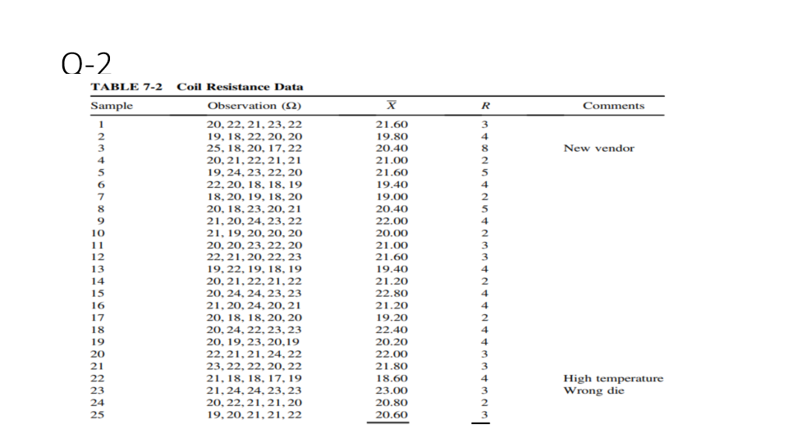
Q-2

Slide 9
Revised chart Revised range=87-(8+4+3)=72 Sample=25-3=22.Grand X revised=521-(20.40+18.60+23.00)=521-62=459(do revised charts)

